Slide 1
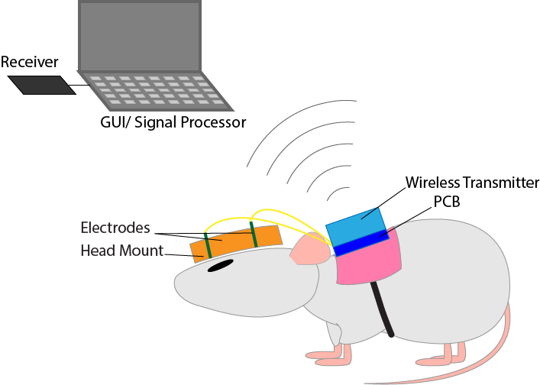
NeuroRat: Non-invasive and Wireless Electroencephalogram for Juvenile Sprague Dawley Rats
Capstone Group C
Daniel Chien, Nithin Dharmaraj, Francis Lin, Catherine Paulson
Notes:
Hello everyone. Our project is designing NeuroRat, a Non-invasive and Wireless Electroencephalography for Juvenile Sprague Dawley Rats.

Slide 2
Traumatic Brain Injury (TBI)
Traumatic Brain Injury (TBI)
1.7 million TBIs occur every year in the U.S.
1 million children enter the ER due to TBI annually
Particular interest in Pediatric TBI
Traumatic Brain Injury in the United States: Emergency Department Visits, Hospitalizations and Deaths 2002–2006. CDC 2010.
Notes:
Francis:
In the United States, 1.7 million traumatic brain injuries occur every year. A traumatic brain injury, or TBI, is when a head injury causes damage to the brain. Children younger than 15 years old are especially at risk for TBI. Each year, a million children are taken to the ER due to TBI and contribute over one billion dollars per year in hospital care costs. In addition, child brains encounter several developmental milestones, and this growth could be negatively impacted by TBI. For these reasons, researchers are particularly interested in pediatric TBI.

Slide 3
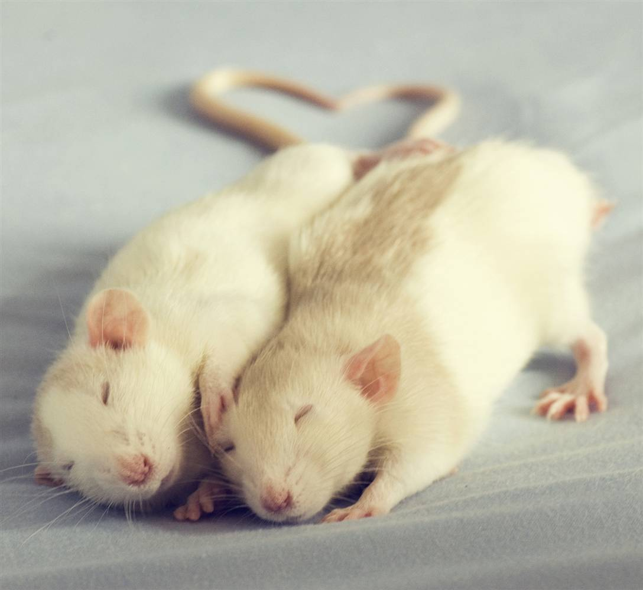
Using Rats as Models
Provides tunable experimental control
Promotes humane research
Serves as a genetically similar model
amazingcentral.com
Notes:
Francis:
To study these effects, researchers often induce TBIs in juvenile rats. Rat models are often used instead of human subjects for ethical reasons and to provide researchers with more tunable parameters during the experiment. This research is performed on rats of age 22 - 26 postnatal days.

Slide 4
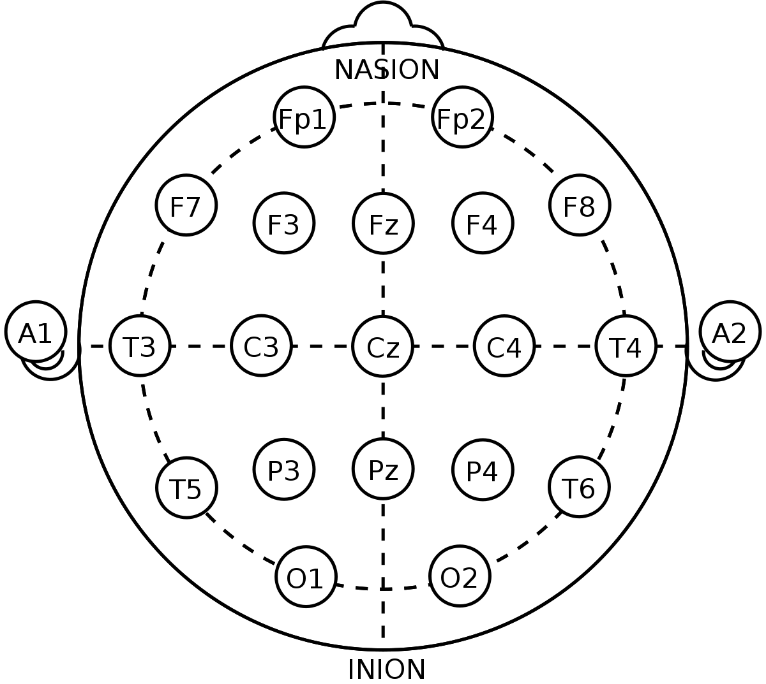
Electroencephalogram (EEG)
Measure electrical activity
Perform frequency domain and
amplitude analyses
Notes:
Erica:
To study TBI in rats, brain waves are determined using an electroencephalogram, or EEG for short. The EEG works by summing up all the electrical activity in the scalp. Previous research has shown that the mean power values of certain frequency ranges in an EEG signal change in subjects with TBI. Therefore, by comparing amplitude and frequency ranges between signals from experimental and control groups, we can get insight into TBI extent.

Slide 5
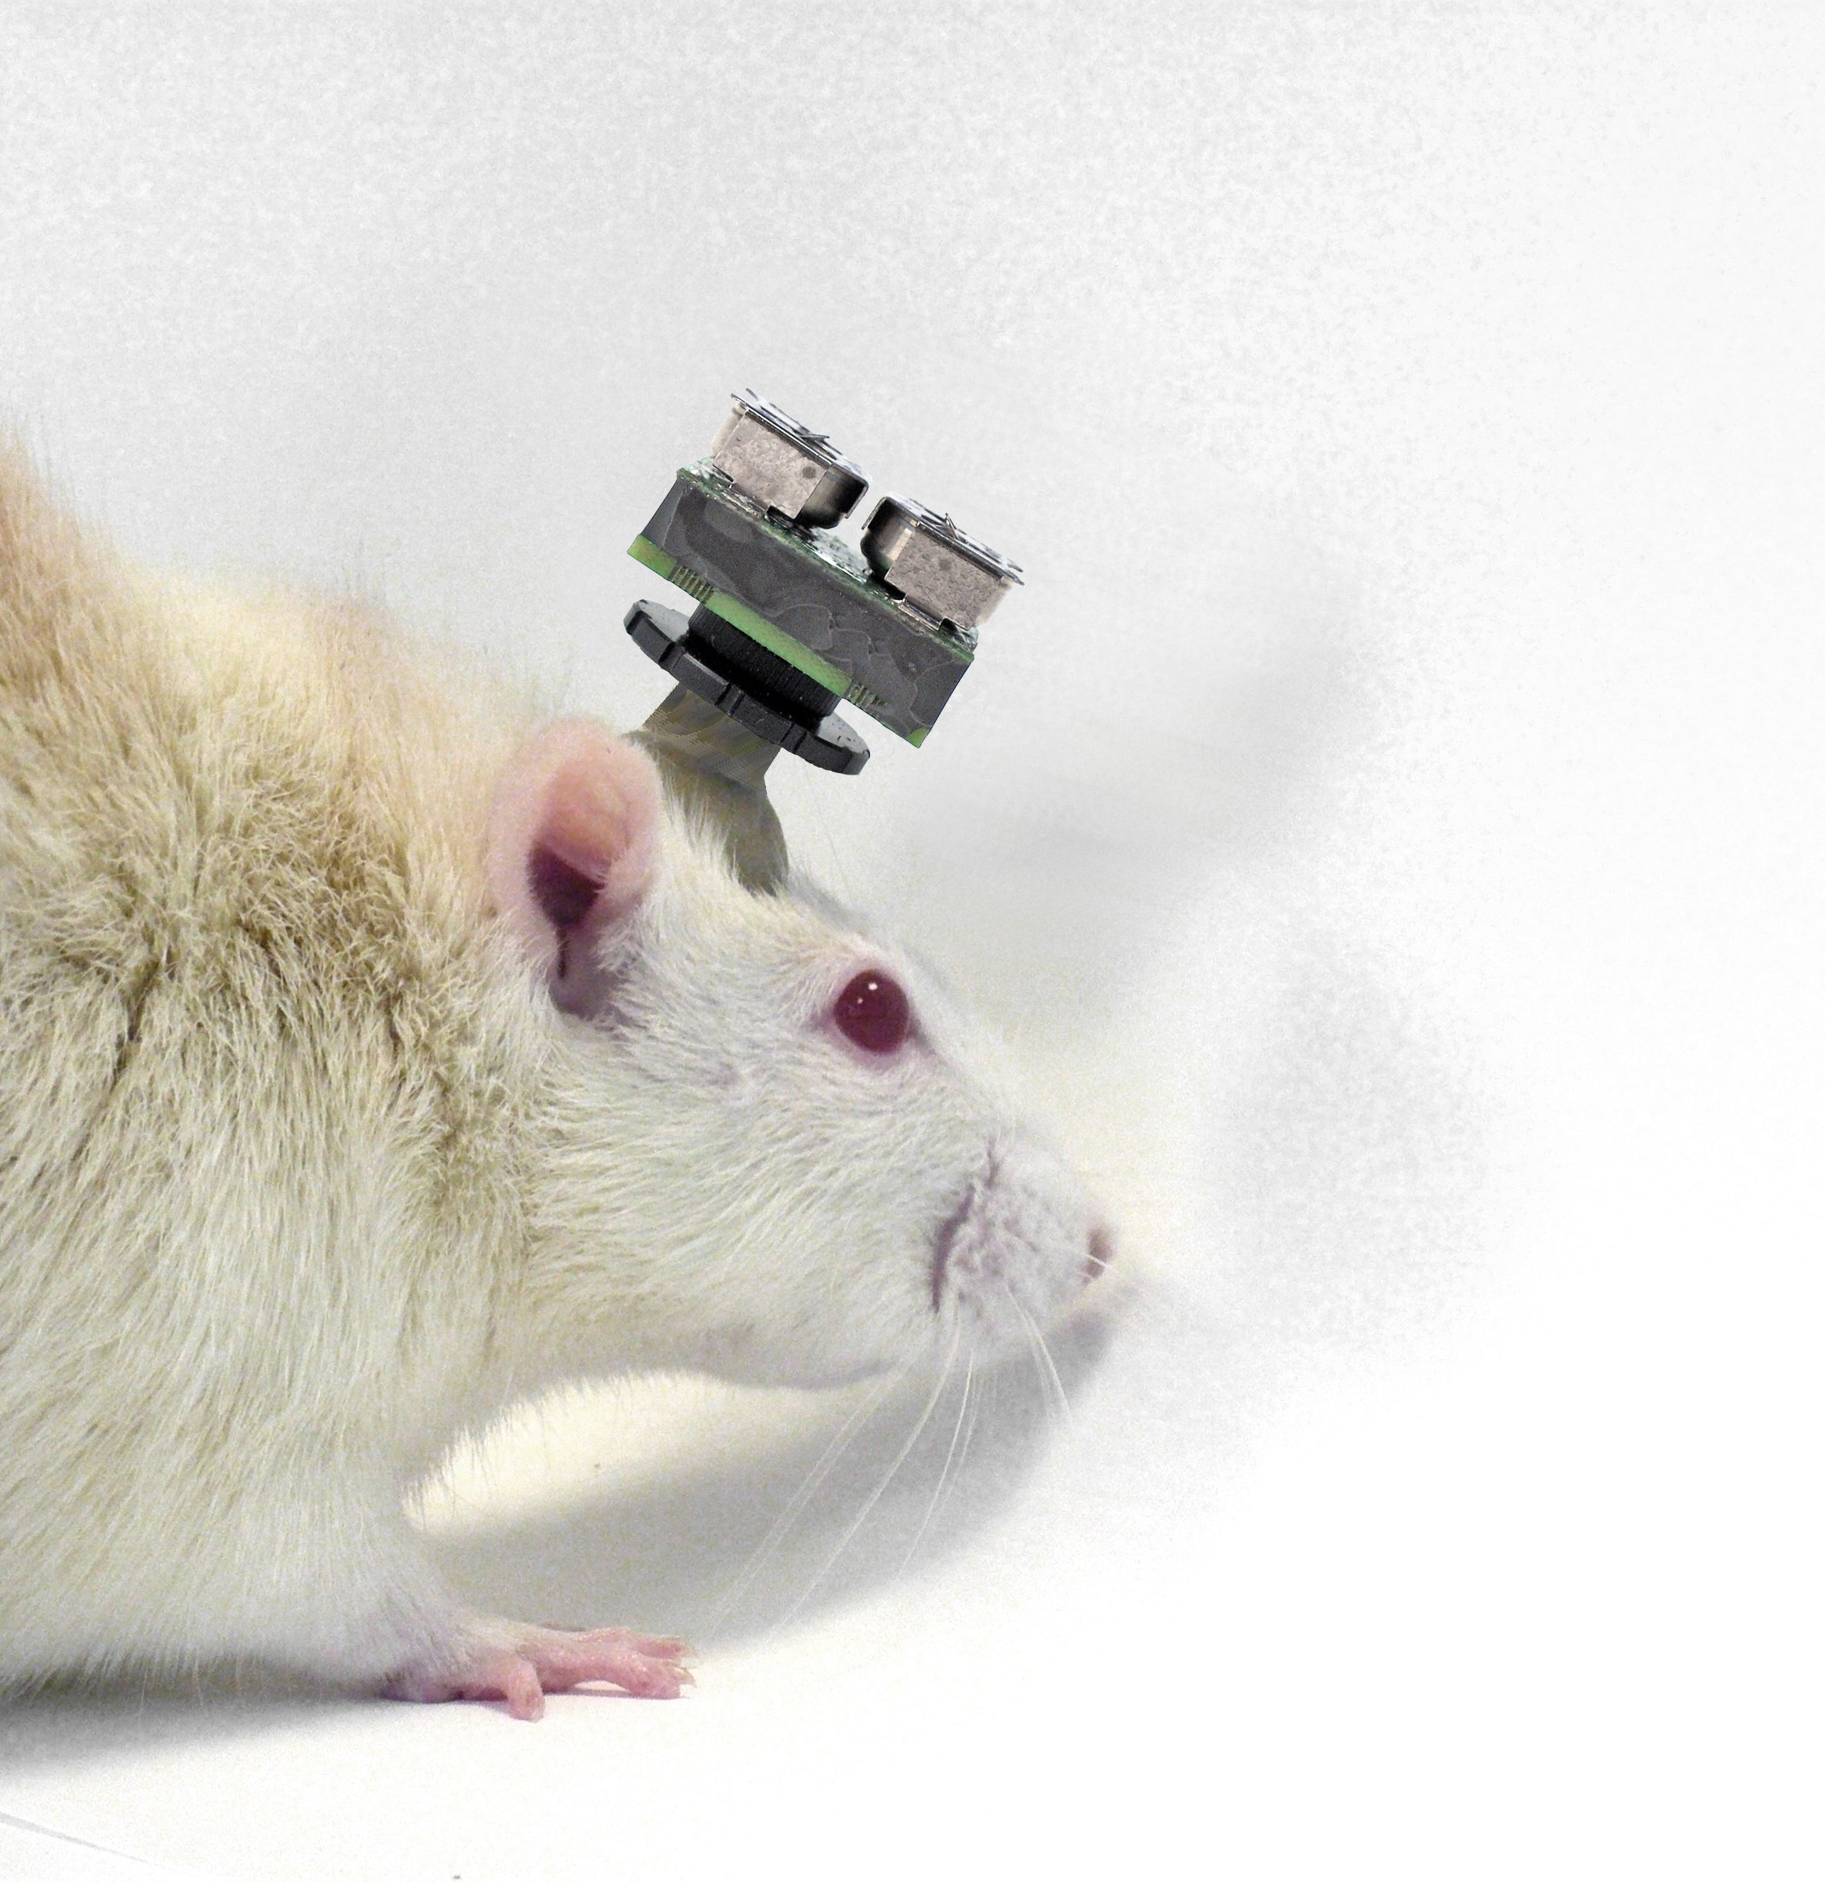
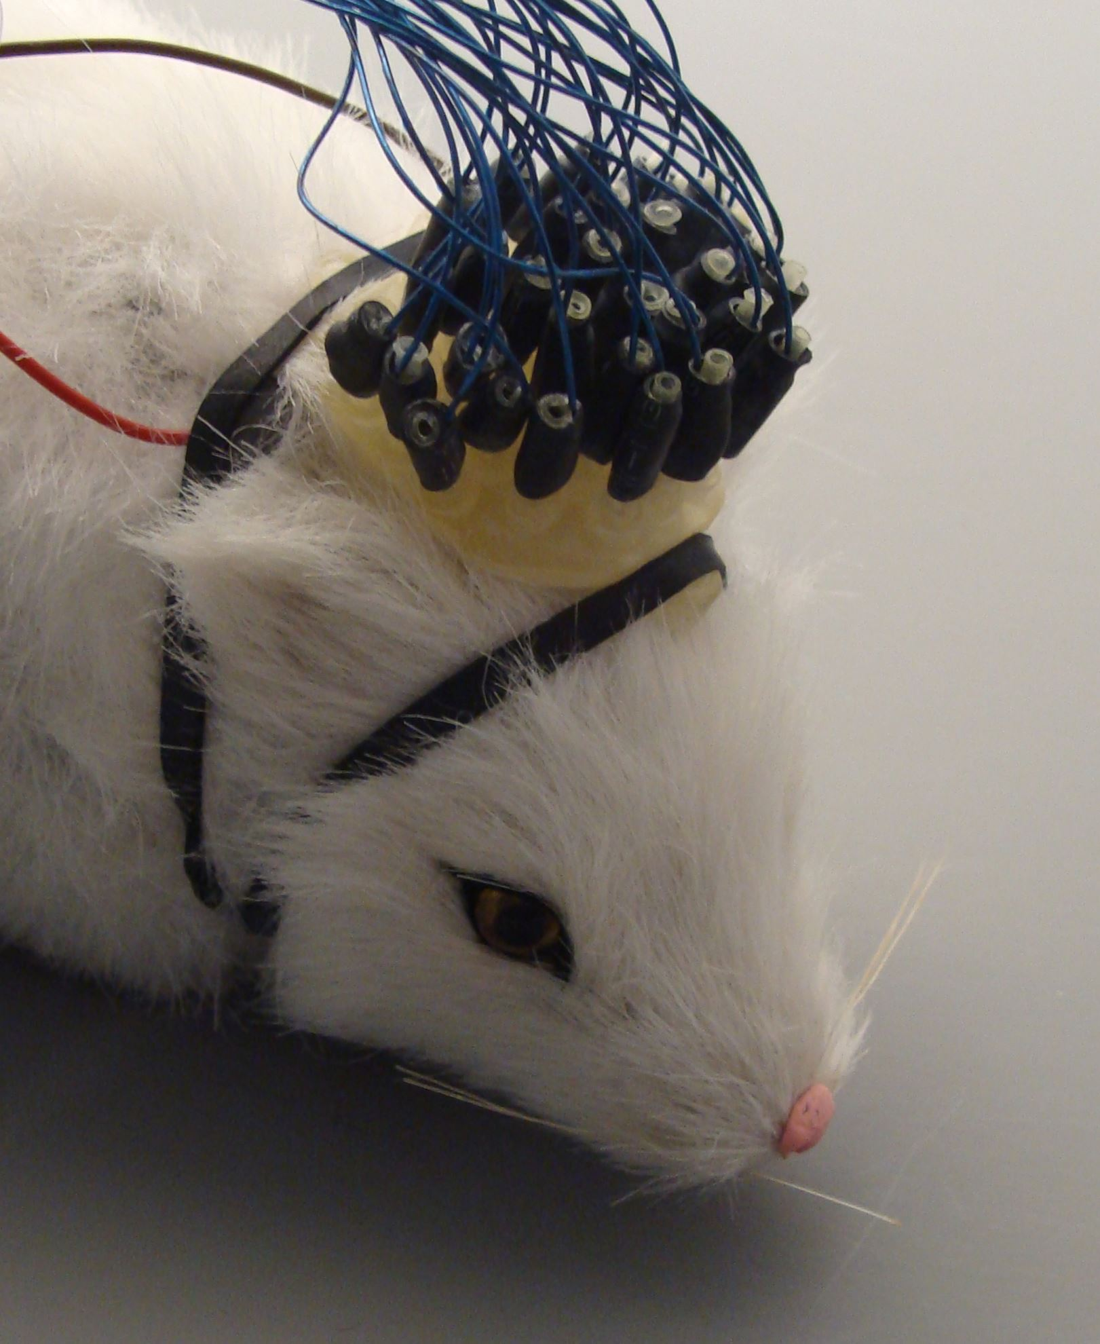
Current Rat EEG Devices
Implanted
Non-invasive
-Invasive
-Risk of infection
-Wired (limits motion)
-Rigid
NeuroRat: Non-invasive, wireless and modular EEG cap for rats
https://www.alnmag.com
https://shop.neurospec.com
Notes:
Erica:
Currently, there are a few rat EEG devices already on the market. However, some EEGs are surgically implanted into the rat, which is invasive and risks infection. Other EEGs are in a non-invasive cap form but are wired. The wires inhibit the rat’s ability to move, which is essential during many behavioral tests. In addition, these caps are rigid, allowing no specific placement of electrodes. Therefore, we have created NeuroRat, a non-invasive, wireless, and modular EEG cap for juvenile rats.

Slide 6
NeuroRat Device Overview
Notes:
Erica:
See here NeuroRat’s overall design. The rat wears a modular head mount that can vary in size and that has embedded electrodes. The electrodes are connected to a chip that amplifies and filters the signal. This chip is worn on the rat’s back in a backpack to make it easier for the rat to carry. This signal is then wirelessly transmitted to a receiver connected to a computer. The computer displays the graphical user interface, or GUI for short, that includes options for signal processing. We will now go into more detail about each component of our device.

Slide 7
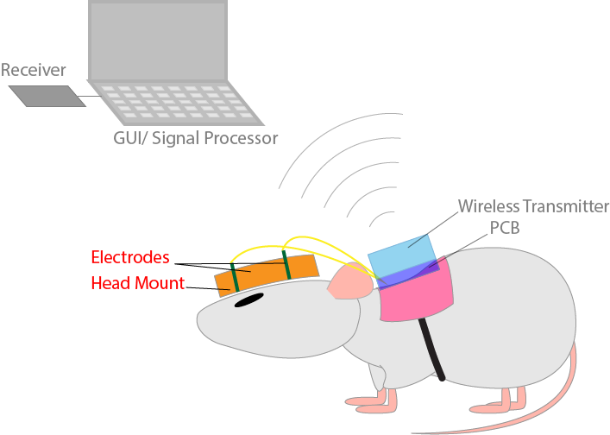
Modular Electrode Mount
Notes:
Catherine:
The first aspect of our device we will discuss is the electrode mount, highlighted here.

Slide 8
Axial Dependent Modular Electrode Mount (ADMEM)
Durable to withstand wear
Modular to allow growth
User friendly for ease of experimentation
Notes:
Catherine:
For NeuroRat, we developed the axial dependent modular electrode mount. Our non-invasive electrode mount is durable enough to withstand any wear an active rat may induce on the device. Electrodes are placed firmly on the rat’s scalp, ensuring good contact and minimizing electrode drift. Our device is modular and can vary in size to accommodate subject growth. Each module is easy to add, remove, and adjust, making our device simple to set up and use.

Slide 9
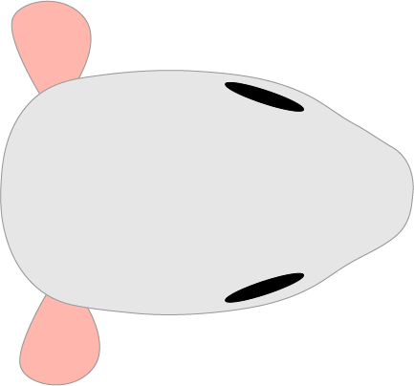
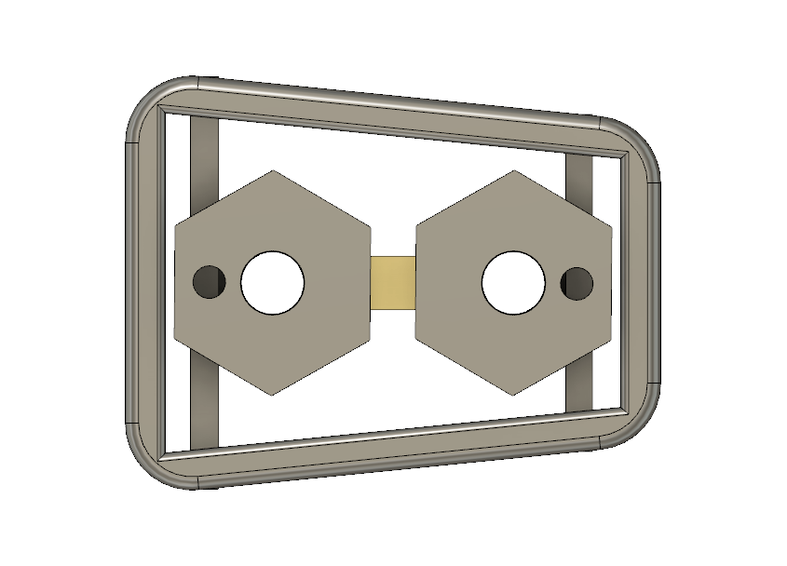
NeuroRat ADMEM
Electrode modules
Head mount
Notes:
Catherine:
Here you can see the placement of the head mount and electrode modules. For ease of use, we designed the mount to follow the geometry of the rat skull. Since the corners of the frame line up with the rat’s ears and eyes, this device can easily be placed on the same region of each rat’s scalp.

Slide 10
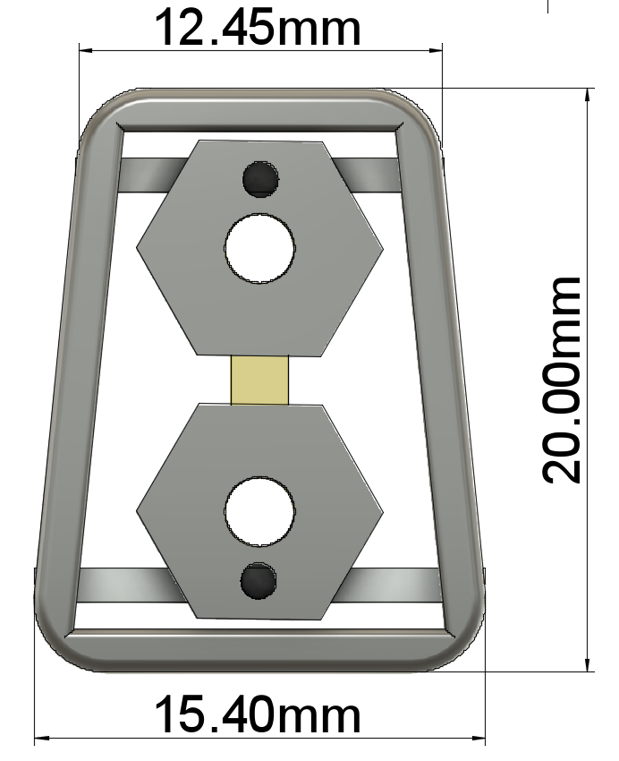
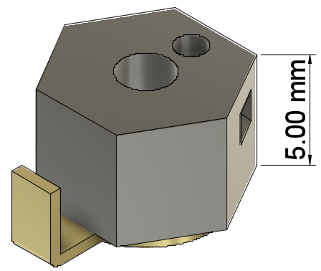
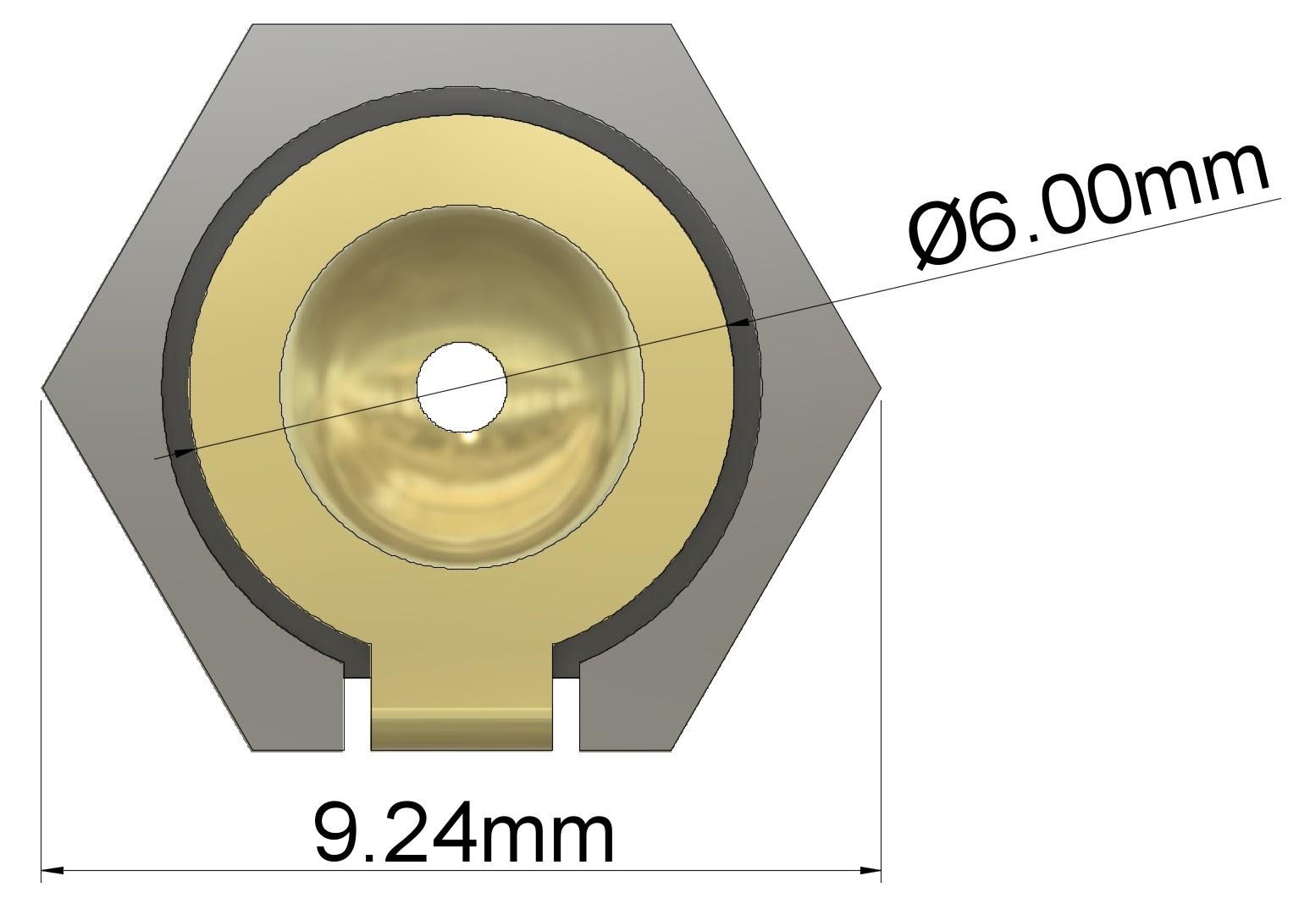
NeuroRat ADMEM
Head Mount
Electrode Casing
3D printed in Thermoplastic Polyurethane (TPU)
Notes:
Catherine:
Shown here are the overall dimensions for the head mount. We chose to print the device in thermoplastic polyurethane, or TPU. This material is widely available for 3D printing, and is also biocompatible. TPU is extremely durable and flexible, so our device can bend to fit and withstand wear.

Slide 11
NeuroRat ADMEM
Notes:
Catherine:
Here’s a demonstration for how the device will function. The mount is adhered to the rat’s scalp. The electrodes can then be added as necessary for each experiment. A bar and rail system is used to attach each electrode to the frame.

Slide 12
NeuroRat ADMEM
Notes:
Catherine:
Here’s a demonstration of how the electrodes can move within the mount. An individual electrode is shown for clarity. The bar and rail system used to attach the electrodes to the frame allows the electrodes to move to any position on the rat’s scalp. Once the electrode is in the desired position, the screws are tightened, and the electrode is secured.

Slide 13
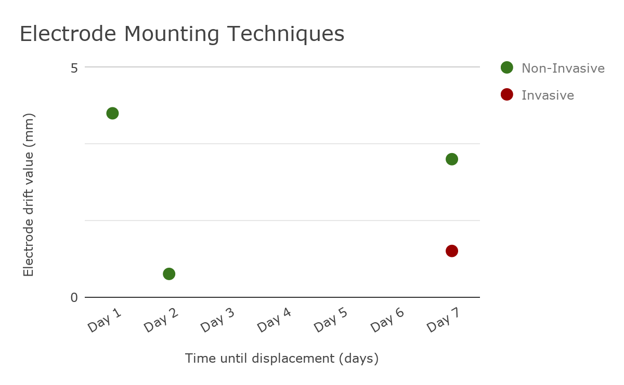
NeuroRat ADMEM
Krazy Glue
Krazy Glue and Dental Cement
Ideal Range
Skull Screws
Dental Cement
Notes:
Catherine:
We explored a variety of mounting techniques to secure the electrodes in place. To quantify how effective they were, we used two criteria; time until displacement and electrode drift value. Electrode drift value is the average distance the electrodes drifted within the mounting area for the duration of the experiment.
We first considered cyanoacrylate, or Krazy glue. While this gave good immediate adhesion, the device is not secure enough to stay mount on active rats. We also considered dental cement. While this gave strong adhesion, the device shifted while the cement cured, making the mounting process frustrating, time consuming, and unreliable. Thus, we combined the two techniques. First, Krazy glue is applied to secure the mount in seconds, then dental cement is applied for added strength.
This whole process takes around 20 minutes per rat. With this technique, the mounts were secured to the rats for at least 4 days, with the last device failure at day 8. When compared to the skull screws, our device does have greater electrode drift. However, our device has a comparable time until displacement, and is still within an acceptable range for electrode drift. This, along with the ease of installing the device and all additional benefits noninvasive devices have makes our device superior.

Slide 14
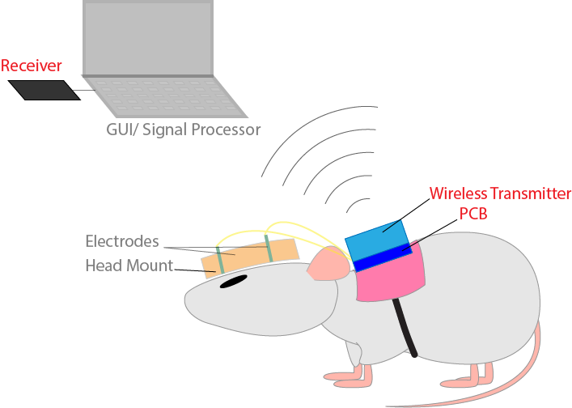
NeuroRat Circuit Design
Notes:
Nithin:
The second phase of our project will be building a printed circuit board that will supplement our head mount and electrodes in acquiring EEG signals from the rat.

Slide 15
NeuroRat Circuit Design
Compact design
Wireless transmission of data for increased rat mobility
User friendly for ease of experimentation
Notes:
Nithin:
When designing our circuit, we wanted to accomplish three main goals. First we wanted our circuit board to be compact to account for the small size of our rats.Secondly, we needed wireless transmission to allow our rats to move freely. Lastly our circuit needed to provide a system that is user friendly for both our rat and human users.

Slide 16
NeuroRat Circuit Design
Analog Front End
Microprocessor
Wireless Transmitter
Notes:
Nithin:
There are three major components to the circuit we will build. We need an Analog Front End, a Microprocessor, and a wireless transmitter.

Slide 17
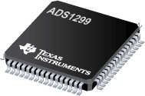
NeuroRat Circuit Design
Analog Front End
Microprocessor
Wireless Transmitter
ADS1299 Chip
Notes:
Nithin:
Our first component is the Analog Front End. For this, we used TI’s ADS1299 Analog Front-End Chip. It has 8 channel acquisition capability along with high speed ADCs and low noise amplifiers, so it is popularly used in EEG signal acquisition.

Slide 18
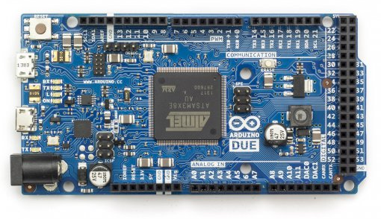
NeuroRat Circuit Design
Analog Front End
Microprocessor
Wireless Transmitter
ADS1299 Chip
SAM3X8E
Notes:
Nithin:
Secondly, we need a microprocessor that is fast enough to control our AFE as well as our wireless transmitter. We chose to go with the Atmel SAM3X8E microprocessor, since it has 84 MHz clock speed and is the same microprocessor used in the Arduino Due which we used for prototyping.

Slide 19
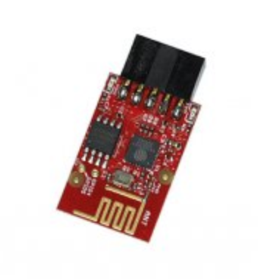
NeuroRat Circuit Design
Analog Front End
Microprocessor
Wireless Transmitter
ADS1299 Chip
SAM3X8E
ESP8266
Notes:
Nithin:
Our third component is the wireless transmitter. We used the ESP8266 to add wireless capabilities to send signals to the computer without data loss.

Slide 20
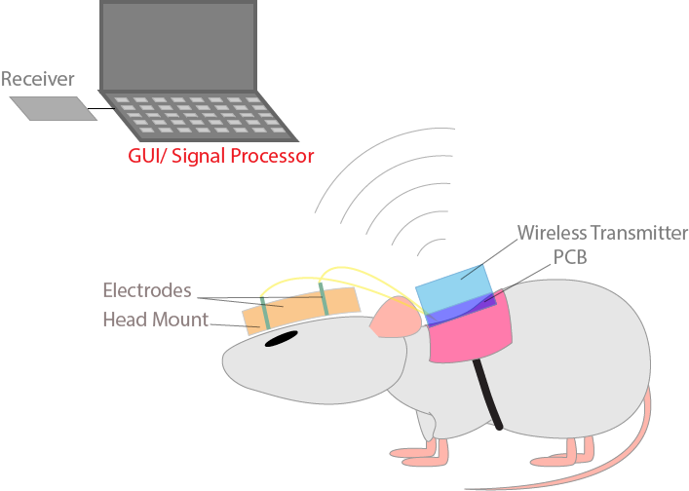
NeuroRat GUI and Signal Processing
Notes:
Daniel:
After this, the signal is displayed on a graphical user interface, or GUI for short.

Slide 21
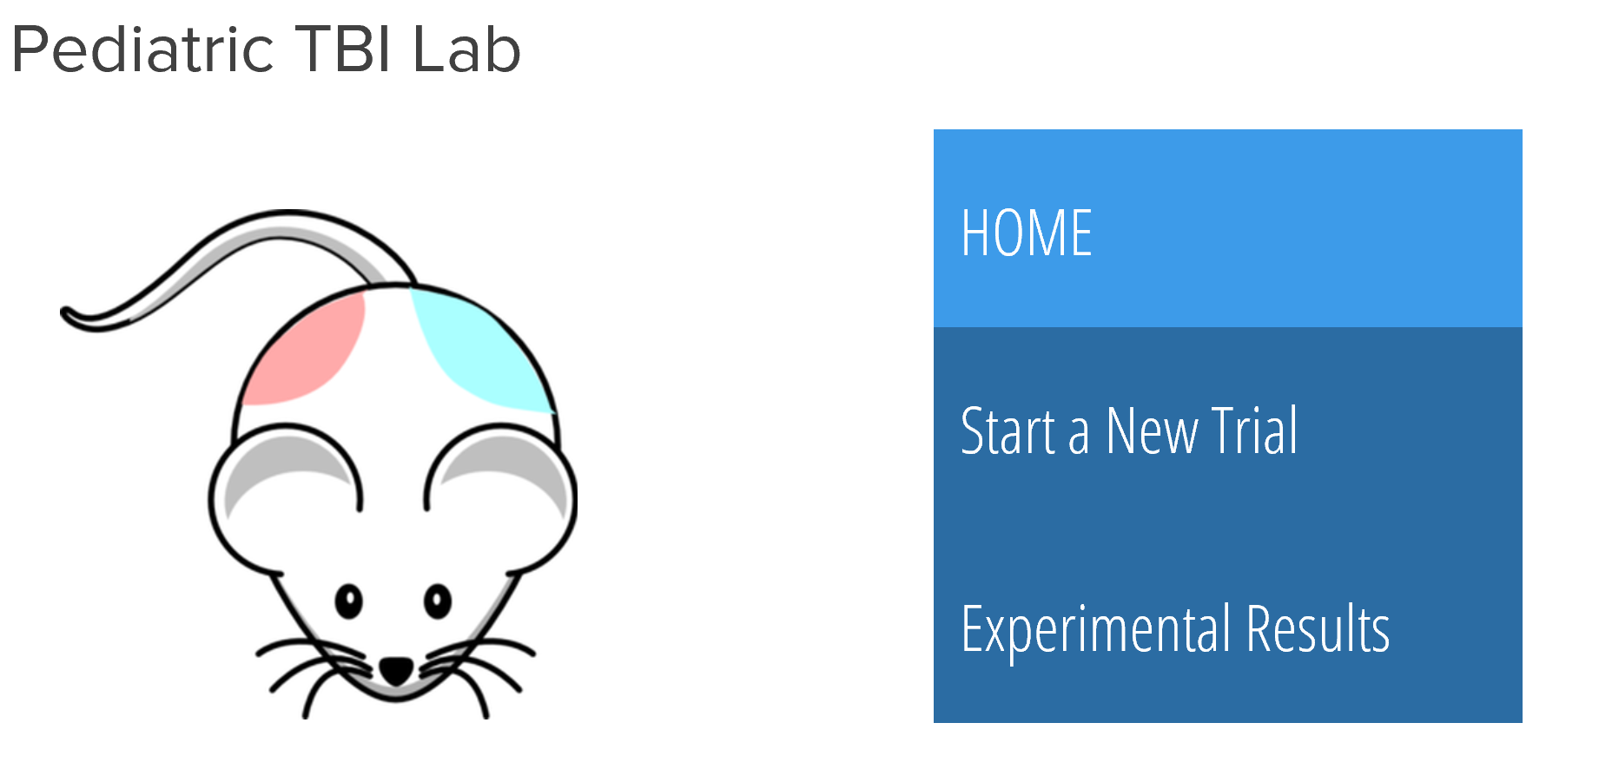
Simple and User Friendly GUI
Display EEG waveform
Employ signal processing algorithms
Design user-friendly interface
Notes:
Daniel:
The GUI processes the data from our data acquisition system and presents the EEG waveforms on screen. It presents the frequency spectrum as well as the signal breakdown of our EEG waves. This GUI is designed to be user friendly so that anyone regardless of their technical background can acquire meaningful EEG signals with a push of a few buttons.

Slide 22
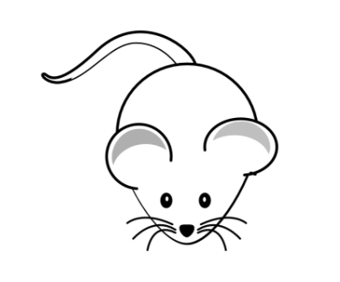
Results: ADMEM
Open Field Test
Less Stressed: More time in center
More Stressed: More time in sides and corners
Notes:
Daniel:
I will be presenting to you our observations regarding how NeuroRat affects rat stress and anxiety.
Explanation of Experiment
We conducted a single open field test with 5 head mounts and 5 subjects to assess this effect.
The open field test rationale
An open field test is a behavioral test commonly used by researchers for assessing rat stress and anxiety. This test involves placing a rat in the center of an open arena, and letting it freely move for a set period of time. Rats are naturally curious and will explore when they are not stressed. Thus, a rat spending more time in the center of the arena is less stressed.
Control and Experimental
For this experiment, our control group had rats with no head-mounts while our experimental group had rats fitted with Neurorat mounts.

Slide 23
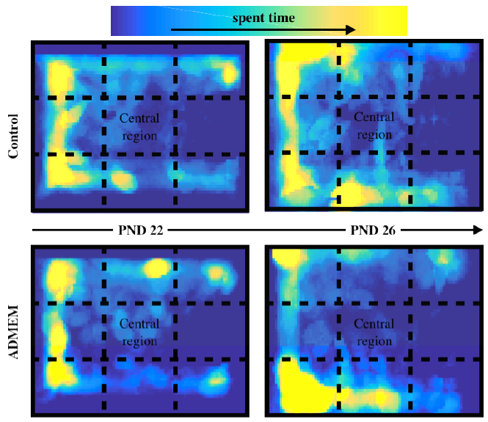
Results: ADMEM
Qualitative: PND 26 rats with NeuroRat mounts showed less time in the center.
5 subjects
5 headmounts
One open field test
Notes:
Daniel:
Control and Experimental
For this experiment, our control group had rats with no head-mounts while our experimental group had rats fitted with Neurorat mounts.
Qualitative
In order to analyze our data, we generated a heat map tracking rat physical activity from video recordings of the open field test. As you can see from the figure on the bottom right, PND 26 experimental group rats, showed a slight decrease in activity in the central region when compared to the control group. This is an indication of late induced anxiety after 4 days.
Quantitative
To quantify these results, we measured the percent time spent in the center. We confirmed our prior analysis, observing a statistically significant difference and verified our observation that PND 26 Rats with the head mounts spent less time in the center. We suspect that this anxiety might be a result of a disruption of the rat’s natural grooming patterns.

Slide 24
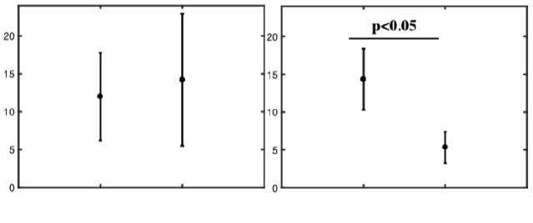
Results: ADMEM
PND 22
PND 26
Quantitative: PND 26 rats with NeuroRat mounts showed less time in the center.
% time in the center
Control ADMEM
Control ADMEM
Notes:
Daniel:
Weight
Finally, we measured the weight of the rats as they developed and found that there was no statistical difference between experimental and control groups, implying that while there is late induced stress, it does not affect the rats eating behaviors or contribute to stress induced weight loss.

Slide 25
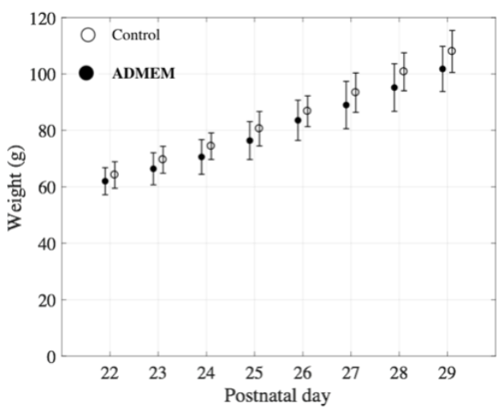
Results: ADMEM
While we observed late-induced stress, NeuroRat does not affect weight or eating behaviors
Notes:
Daniel:
In conclusion while there is a slight late induced anxiety, it wasn’t enough to disrupt eating behaviors. Our future designs for Neurorat will attempt to resolve this by making parts of the mount removable to expose the head for scratching and grooming.

Slide 26
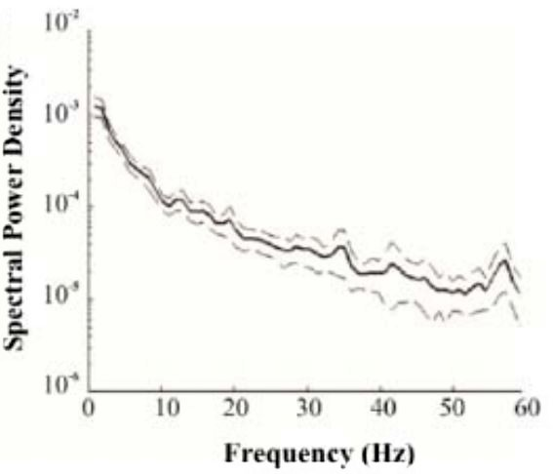
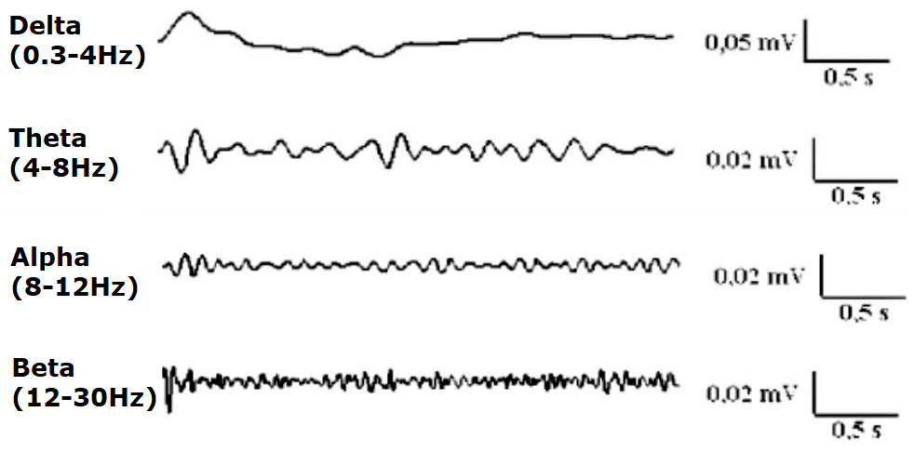
Results: Circuitry
Verify our signal using past literature values
Notes:
Francis:
Next, we will be discussing our circuitry results. We have a prototype of the Neurorat circuit and are doing some preliminary testing. To verify the signals collected by the circuit, we will take the raw EEG signal, apply a few signal processing techniques and compare them to past literature. First, we will calculate the power spectral density for our signal. A power spectral density describes the power of the signal as a function of frequency. We expect frequencies below 40Hz to be dominant in our power spectral density. Next, we will separate our signal into four frequency bands: delta, theta, alpha, and beta, and compare the amplitude of these bands to those in literature. We will display these results in the Neurorat GUI.

Slide 27
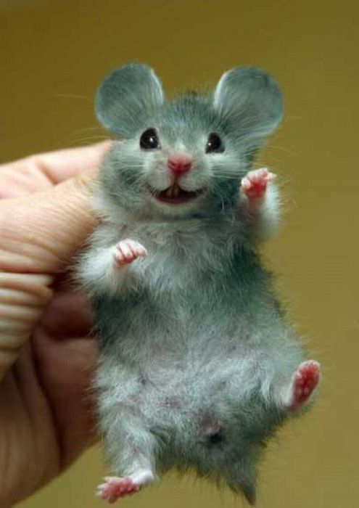
NeuroRat
Modular to match physical development
Wireless to allow for rat mobility
Non-invasive to prevent infection
1funny.com
Notes:
Francis:
In summary, Neurorat is a modular, wireless, and non-invasive EEG cap for juvenile rats. The modular feature allows for specific electrode placement and accommodates rat growth. The wireless feature allows rats to be active, which is important for many behavioral tests. Lastly, the noninvasive feature promotes humane research and prevents infection in rats.

Slide 28
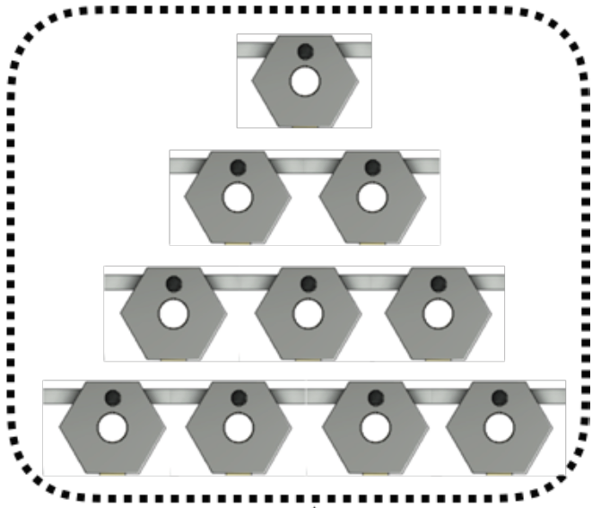
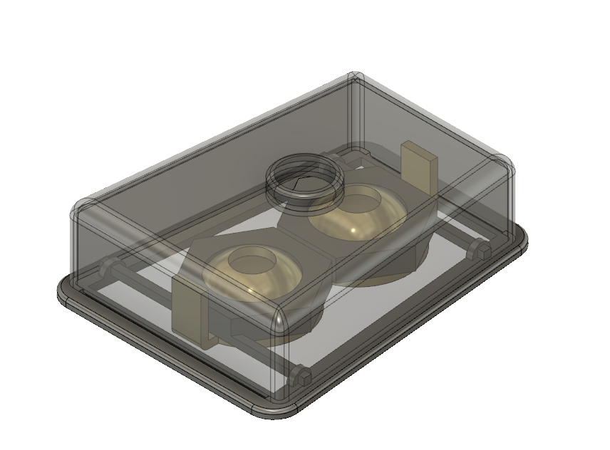
Future Directions
Shrinking electrodes to include more
Add a protective cover to head mount
Integrate head mount with circuitry
Notes:
Francis:
However, our work is not yet done. We would like to use smaller electrodes to increase the number of electrodes in our system. Also, we would like to add a protective removable cover over the head mount to prevent electrode damage and allow rats to groom to reduce anxiety. Finally, we need to integrate the head mount with our circuitry. These changes will help Neurorat be an even more effective research tool.

Slide 29
Acknowledgements
Project Mentor: Dr. Sargolzaei, Dr. Cai, Professor Harris, Professor Giza
Faculty Mentors: Professor Seidlits, Dr. Saddik, Professor Schmidt
TA Mentors: Rebecca Bierman, and all other TA’s
Notes:
Erica:
As mentioned in our motivation section, 1 million children enter the ER annually due to TBIs. As these children grow, their injuries grow as well, which increases the impact that TBI has on their lives. We hope that you will join us in helping children by equipping the pediatric research community with easy-to-use tools to combat TBI and other neurophysiological diseases.
And with that, we’d like to thank our project mentor, Dr. Saman Sargolzaei and his team, our faculty mentors, Professor Stephanie Seidlits, Professor George Saddik and Professor Jacob Schmidt, and our TA mentor, Rebecca Bierman and all other TAs who have helped us. Thank you for your time, and we’d be happy to take any questions you may have.

Slide 30
Thank you!
Questions?

Slide 31
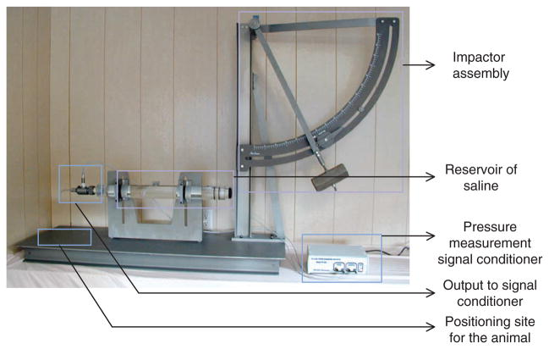
Fluid Percussion Injury (FPI)
Popular method to induce TBI in animal models
Pendulum is released and strikes piston to cause pressure pulse on the dura of the brain
Severity and location of FPI can be controlled
Kabadi, Shruti, et. al. Fluid-percussion–induced traumatic brain injury model in rats (2013)

Slide 32
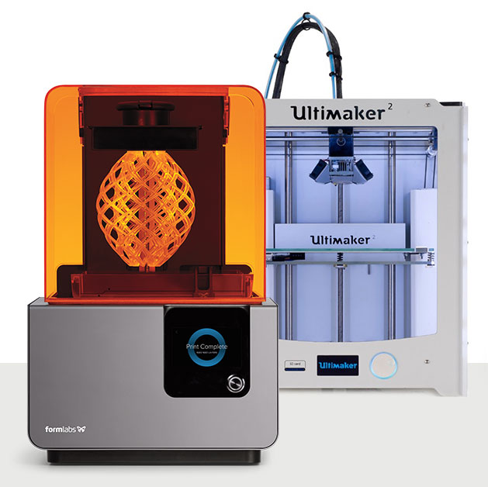
3D Printing
Fused Deposition Modeling (FDM)
Most common type of 3D printer
Material heated and extruded, part
built layer by layer
0.1mm layer thickness
Stereolithography (SLA)
Resin cured using UV laser
High precision and strength
0.025mm layer thickness
https://pinshape.com/blog/fdm-vs-sla-how-does-3d-printer-tech-work/

Slide 33
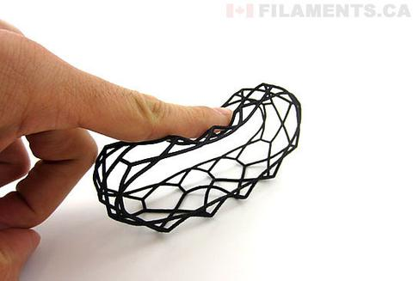
Thermoplastic Polyurethane
High Elasticity/Abrasion Resistance
Necessary durability and flexibility
to withstand wear from rats
Used in Medical Devices
Biocompatible, non-toxic
Widely Available for 3D Printing
Low cost, wide range of materials
and printing techniques available
https://filaments.ca/products/polyurethane-tpu-filament-natural-1-75mm

Slide 34
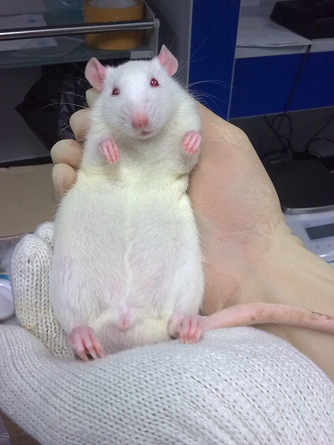
Device Weight Implications
Rats can support 10% of body weight without behavioral impact
Sprague-Dawley Rats weigh 50g at 3 weeks old.
Taconic Biosciences, Preferred for safety and efficacy, surgical modifications and reproductive studies

Slide 35
Adaptable for Other Areas of Research
Pediatric epilepsy affects 470,000 children in the United States alone
CTE (Chronic Traumatic encephalopathy) was present in 96.8% of all deceased pro football players
https://www.rt.com/usa/192316-frontline-football-brain-cte/
https://www.cdc.gov/epilepsy/basics/fast-facts.htm
Notes:
Our device can also be applied to research for pediatric epilepsy and general epilepsy. Pediatric epilepsy affects 470,000 children in the United States alone, with general epilepsy affecting 3.4 million people nationwide. The flexible nature of our device allows it to be used both for young rats and adult rats, allowing it to be used for most neurological research for rats of any age and size.

Slide 36
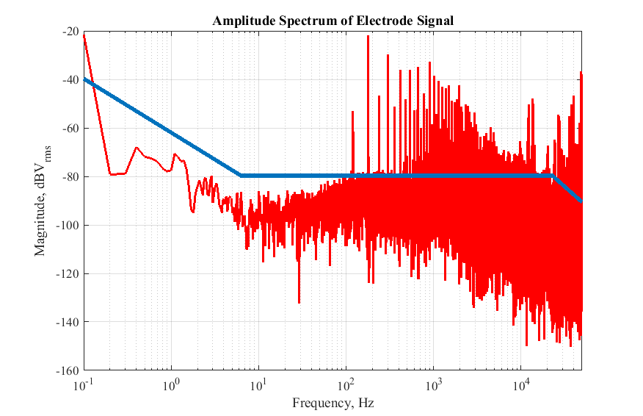
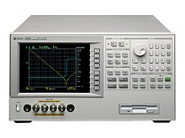
Electrode Testing
Impedance testing
Noise Measurements
Notes:
Our device can also be applied to research for pediatric epilepsy and general epilepsy. Pediatric epilepsy affects 470,000 children in the United States alone, with general epilepsy affecting 3.4 million people nationwide. The flexible nature of our device allows it to be used both for young rats and adult rats, allowing it to be used for most neurological research for rats of any age and size.

Slide 37
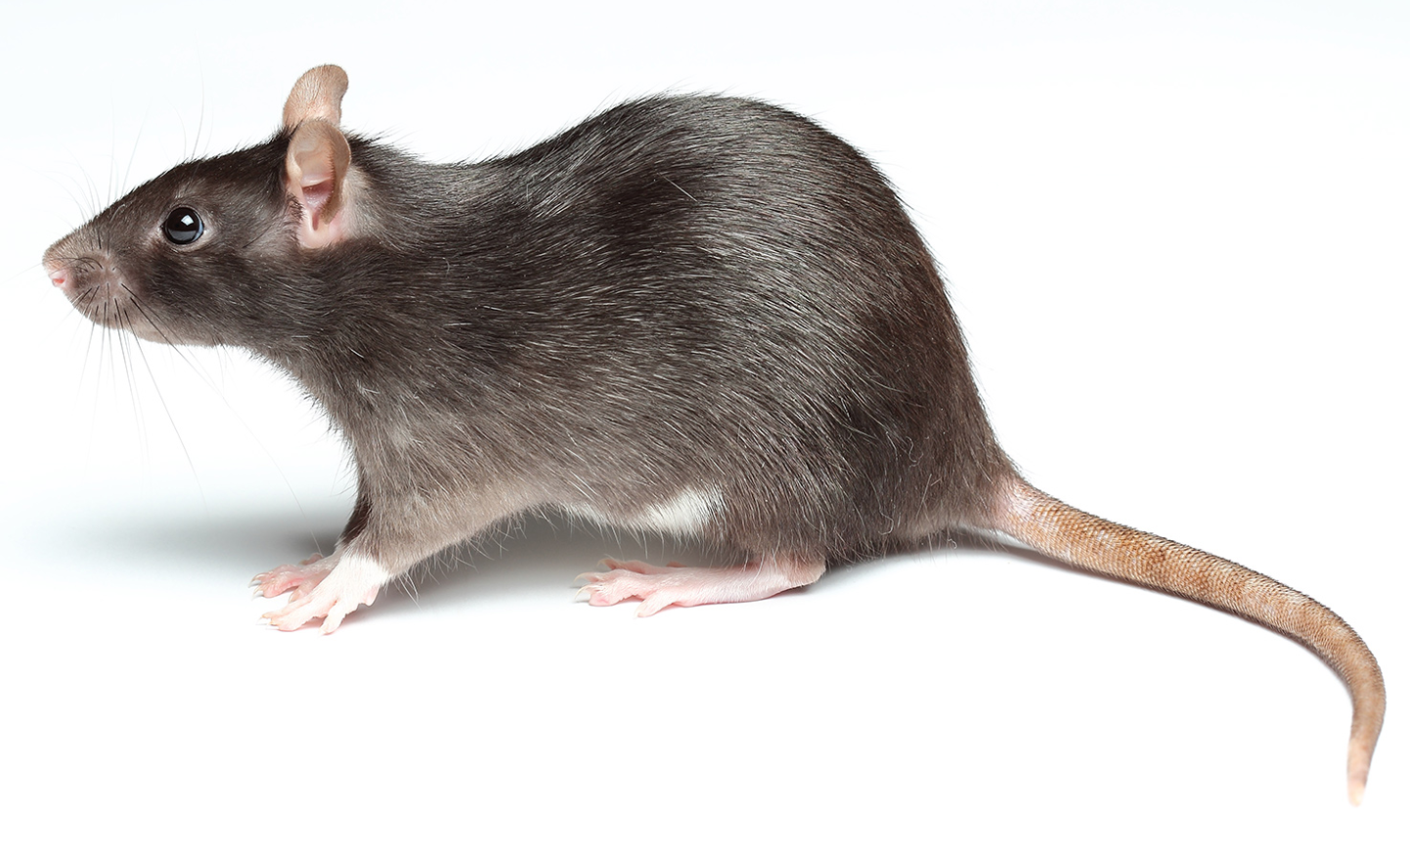
Novel Object Recognition (NOR) Test
Conducted before and after induced injury
Current data: time spent at each object
Brain wave signals would give more insight into rat’s cognitive processes

Slide 38
GUI- Experimental Data

Slide 39
Rat EEG and Human EEG Are Very Similar
 | Amplitude | Frequency
Rat | 1 - 25 uV | Delta (0.3 to 4Hz) Theta (4-8Hz) Alpha (8-12Hz) Beta (12-30Hz)
Human | 10 - 100 uV | Delta (0.3 to 4Hz) Theta (4-7Hz) Alpha (8-15Hz) Beta (16-31Hz)
Ferrari, Arce, et. al. (2013)

Slide 40
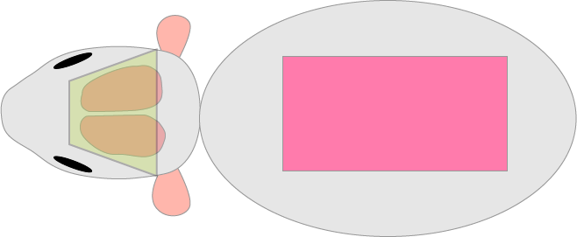
Rat Backpack
Wireless Transmitter
Micro-
processor
Analog
Front End
5 cm

Slide 41
ADS1299 Analog Front End for Data Acquisition
High speed Analog to Digital Conversion
Low noise amplifiers
Small size

Slide 42
ATSAM3X8E Microprocessor to Run ADS1299
84 MHz clock speed
Used in Arduino Due
Ease of transfer between prototype and PCB

Slide 43
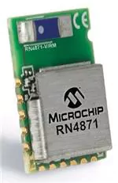
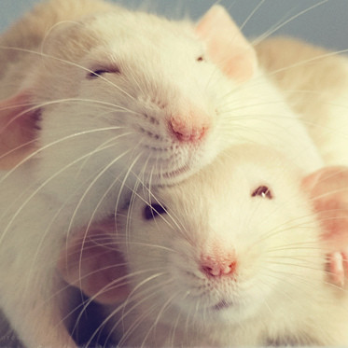
Wireless Data Transfer Through Bluetooth
Enable rats to move freely
Includes low energy feature
Simplify experimental setup
https://pbs.twimg.com/profile_images/639480869376393217/g1GCaUaD.png

Slide 44
Circuit Design
Analog Front End
Microprocessor
Wireless Transmitter
TI ADS1299 Chip
High speed analog to digital conversion
Low noise amplifiers
Small size
Atmel SAM3X8E
84 MHz clock speed
Used in Arduino Due
ESP 8266
Enable rat mobility
Low energy feature
Simplify experiment set up

Slide 45
Results: GUI

Slide 46
NeuroRat ADMEM
Notes:
***VIDEO showing electrodes sliding back and forth

Slide 47
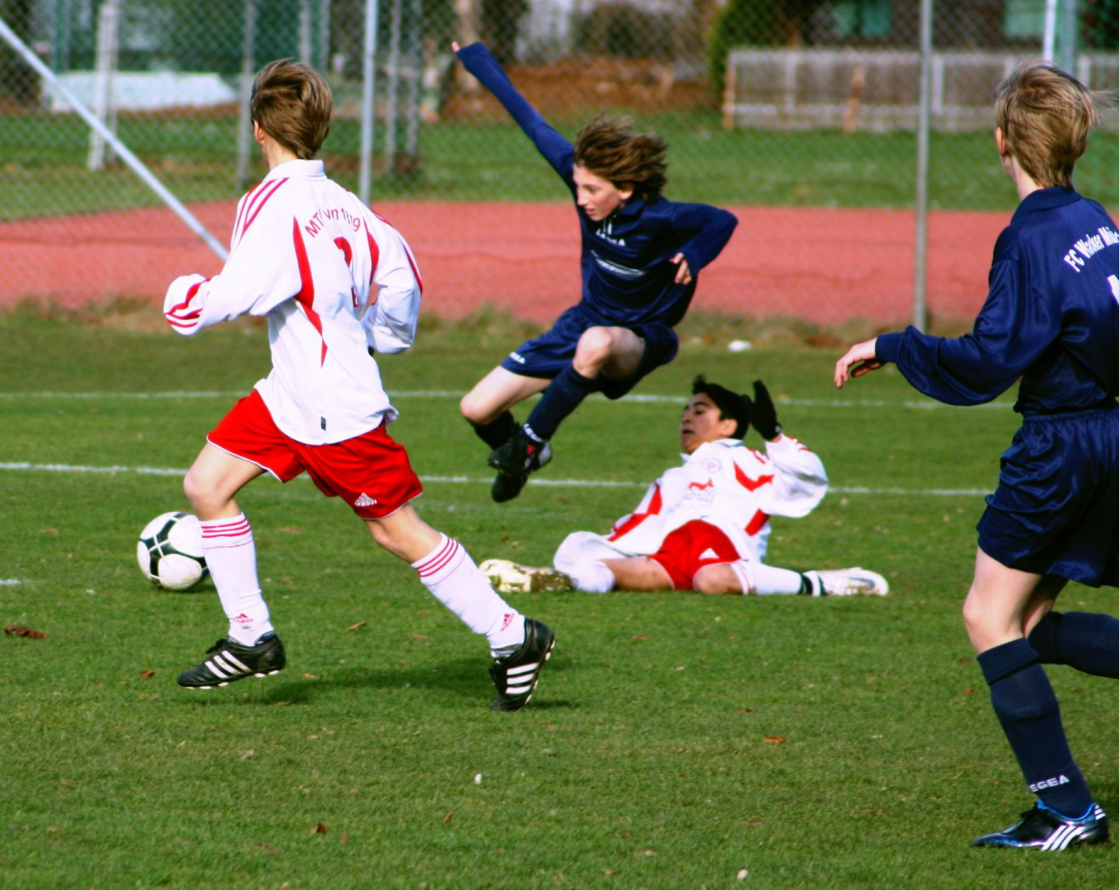
Aiding Pediatric TBI Research
1 million children enter the ER as a result of TBI every year
Injuries to developing brains evolve over time
http://www.tbi.org/pediatric-tbi/children-with-traumatic-brain-injuries.html
Notes:
Our device aids pediatric TBI research by providing a more effective tool for researchers to utilize to understand the ever evolving child’s brain. Every year, 1 million children enter the ER as a result of Traumatic Brain injury. What makes injuries to children even more devastating is that the injuries evolve over time as children’s brains continue to develop. Thus injuries that might seem minor could end up becoming catastrophic several years down the line. Our device makes it easier for researchers to utilize animal models to understand the complex brain of children.

